Slide 1
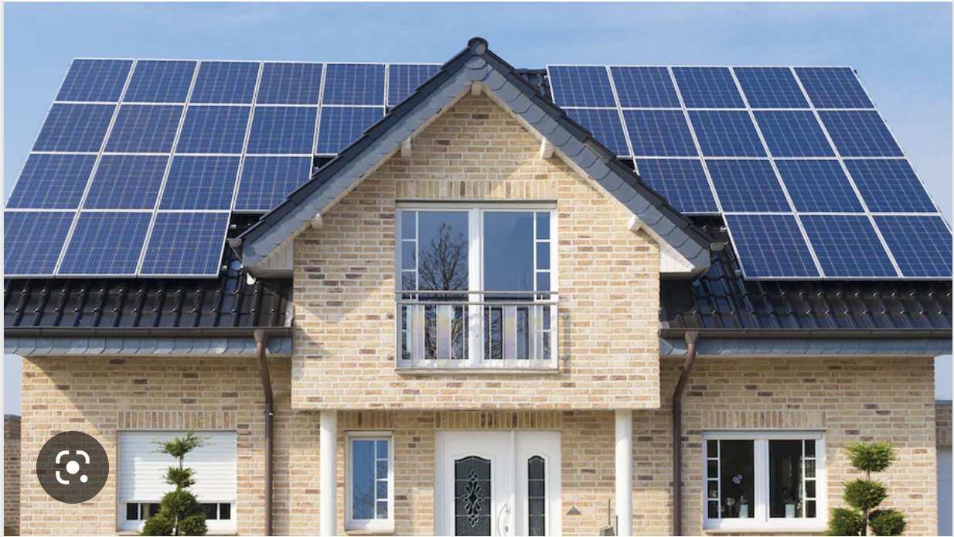
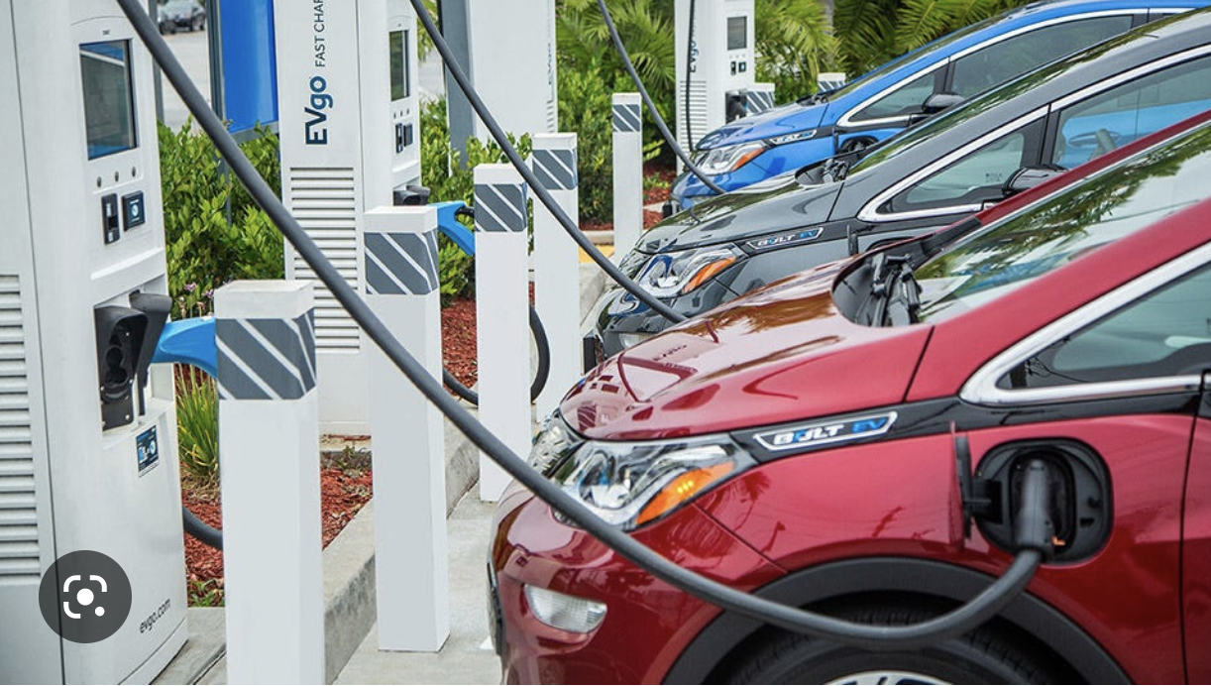
The Inflation Reduction Act
An Introduction
Notes:
• I’ve modified a CCL slide deck for this presentation
• Please, put your questions in the Chat; we’ll address them after the talk
[This talk was given at the Building Electrification webinar, "Electrifying Buildings: Real Life Stories,” Nov. 17, 2022.]

Slide 2

About Our Speaker
Bob
Morrow
Member, Lincroft Chapter, Citizens Climate Lobby
Retired history professor, Morgan State University

Slide 3
3 Main Points to learn about:
The Inflation Reduction Act’s goal: big emissions cuts
How does the Act accomplish this goal?
A Look at the Rewiring America Savings Calculator

Slide 4
A big step forward in the
fight against climate change
40% climate pollution cuts by 2030
Notes:
• The experts agree that the landmark significance of the Inflation Reduction Act
• Reduce 40% by 2030
• Not to Paris commitment: 50% by 2030

Slide 5
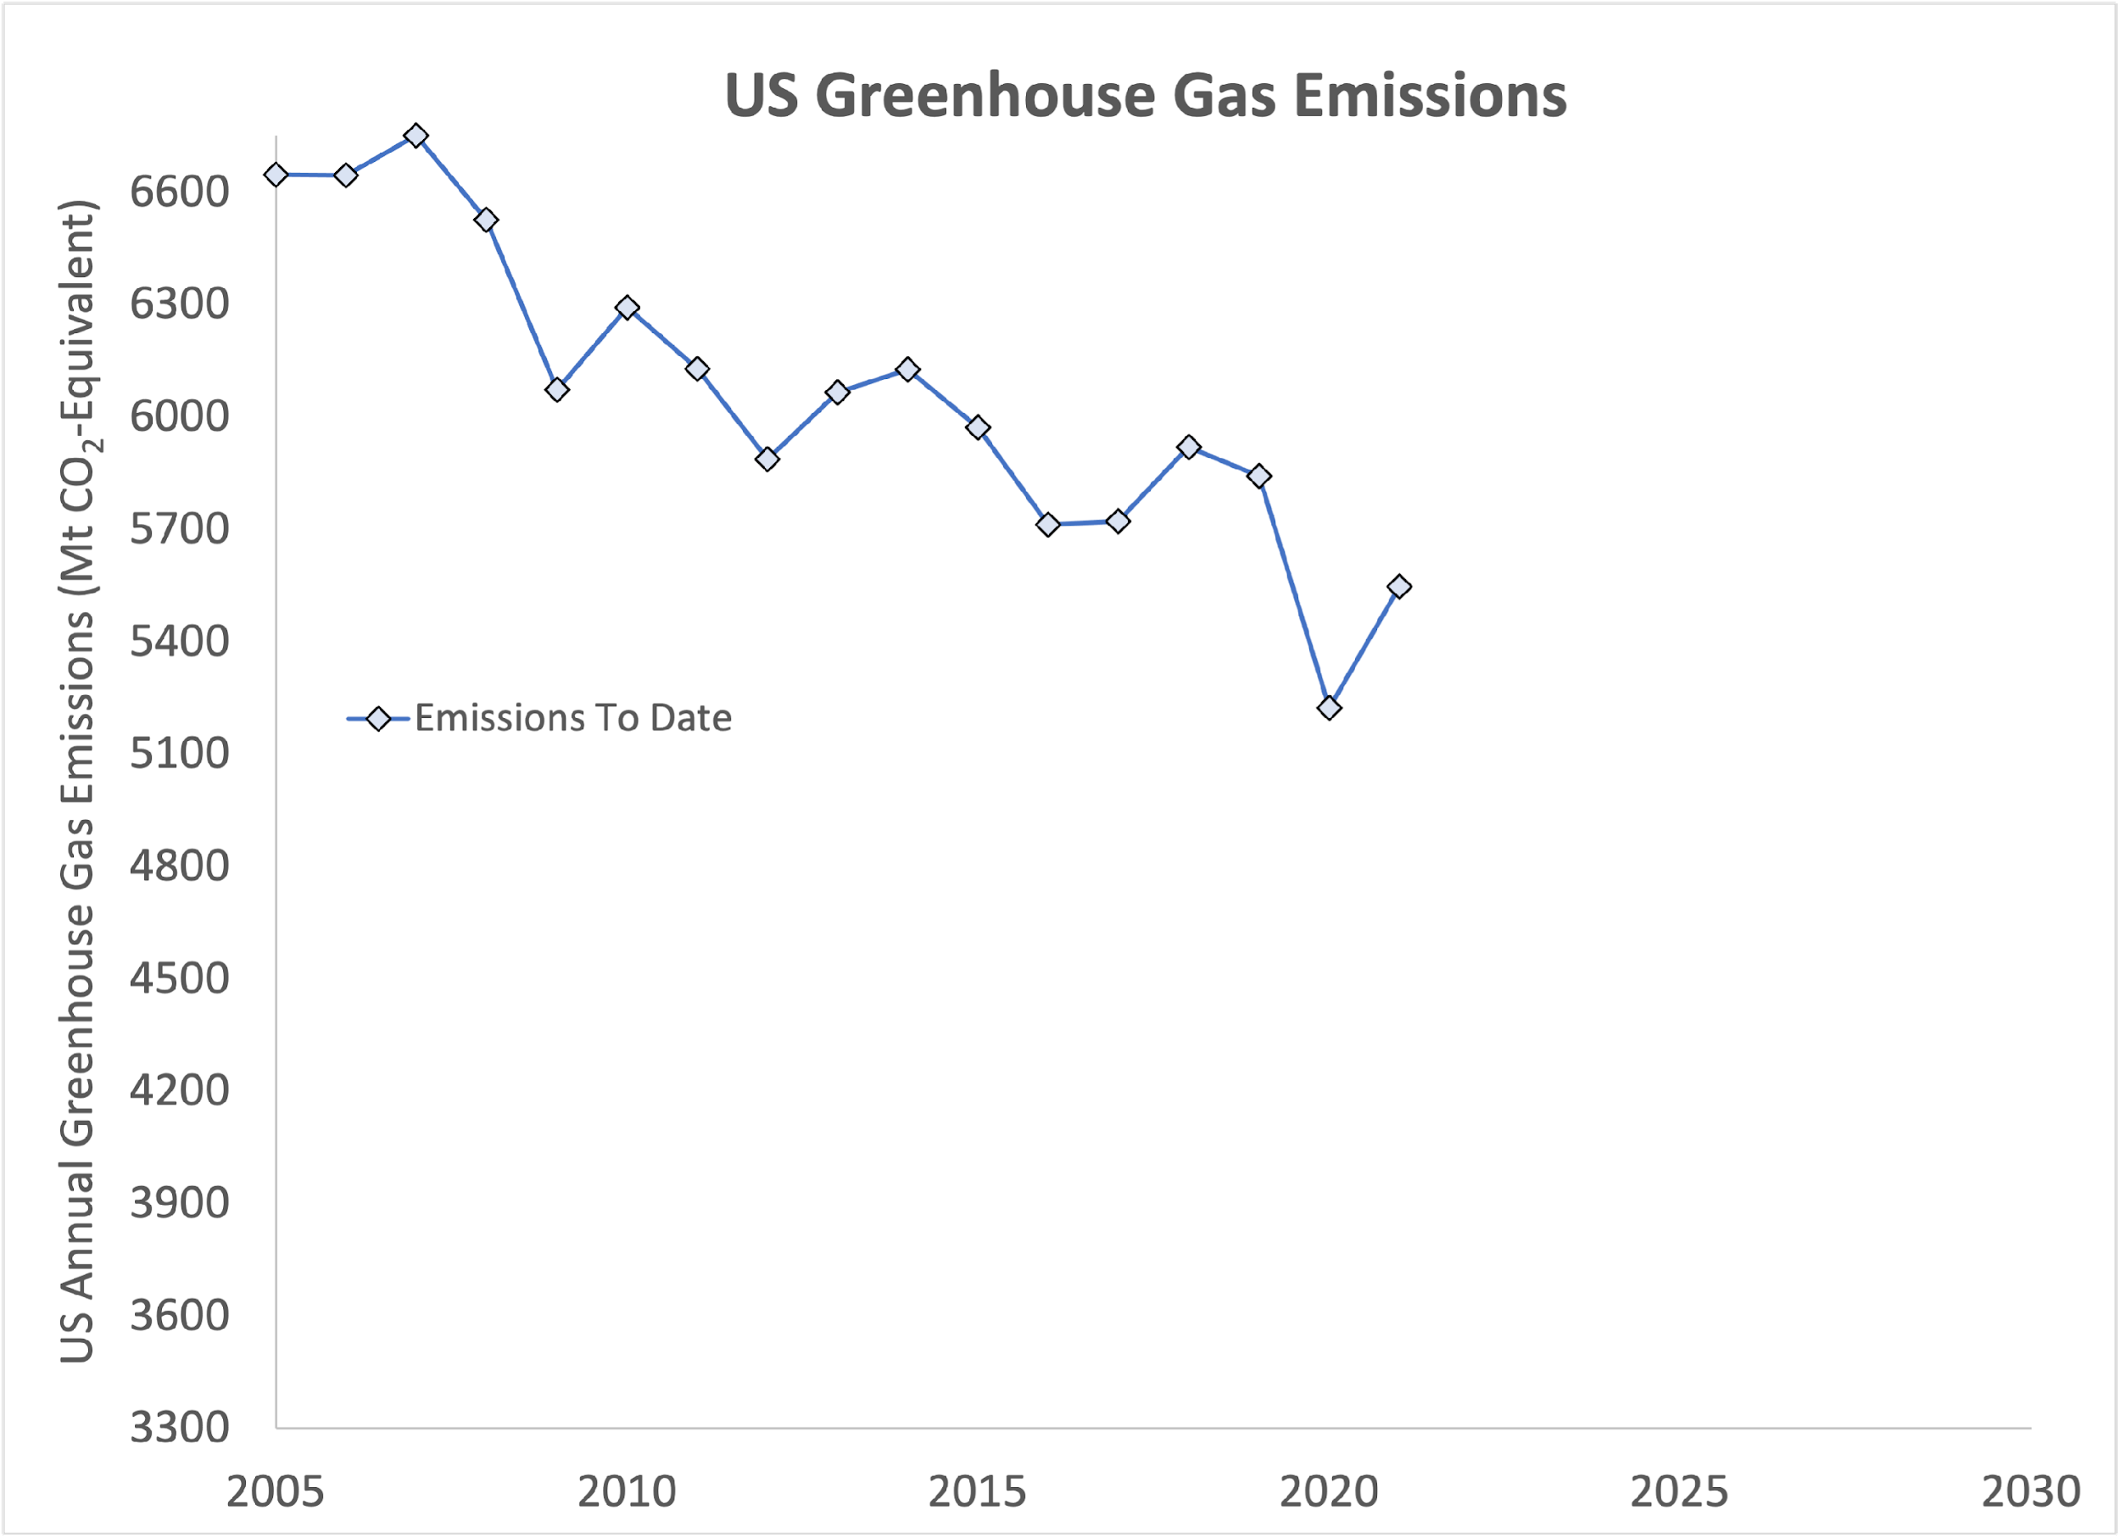
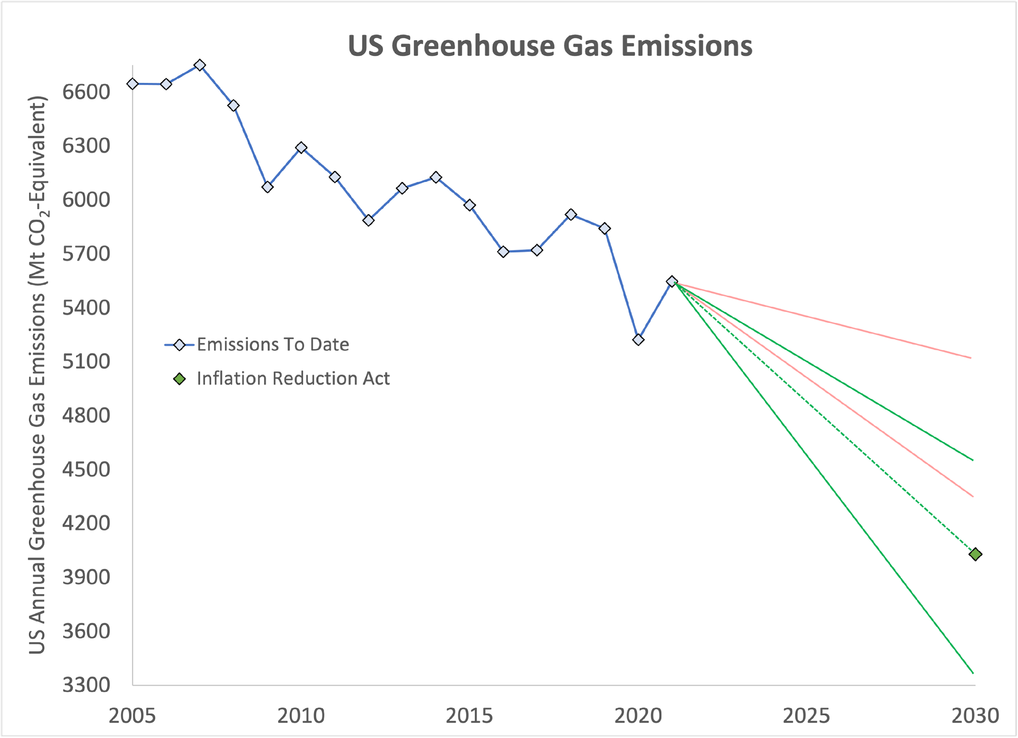
Paris
Target
Notes:
• Where we are now
- Explain the slide layout
- Some improvement as natural gas replaces coal

Slide 6
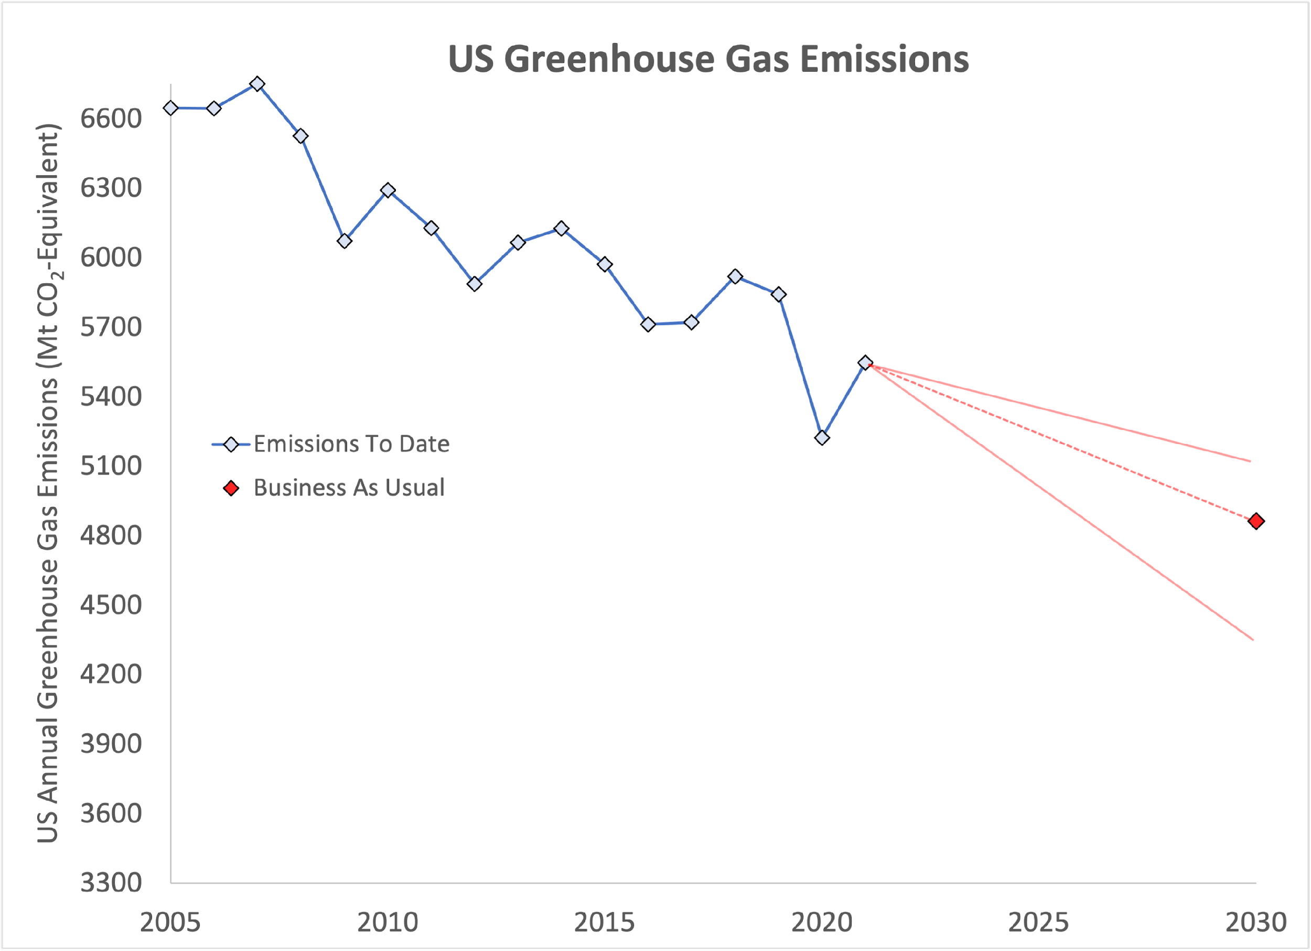
Business as Usual
27% cut
Paris
Target
Notes:
• Energy modeling groups
- Princeton, Rhodium and Energy Innovation
- predict just 27% below 2005 levels by 2030
- only 50% by 2030 of Paris commitment.
Sources: EPA GHG emissions inventory, Rhodium, Energy Innovation, and Princeton REPEAT analyses. Chart by Dana Nuccitelli

Slide 7
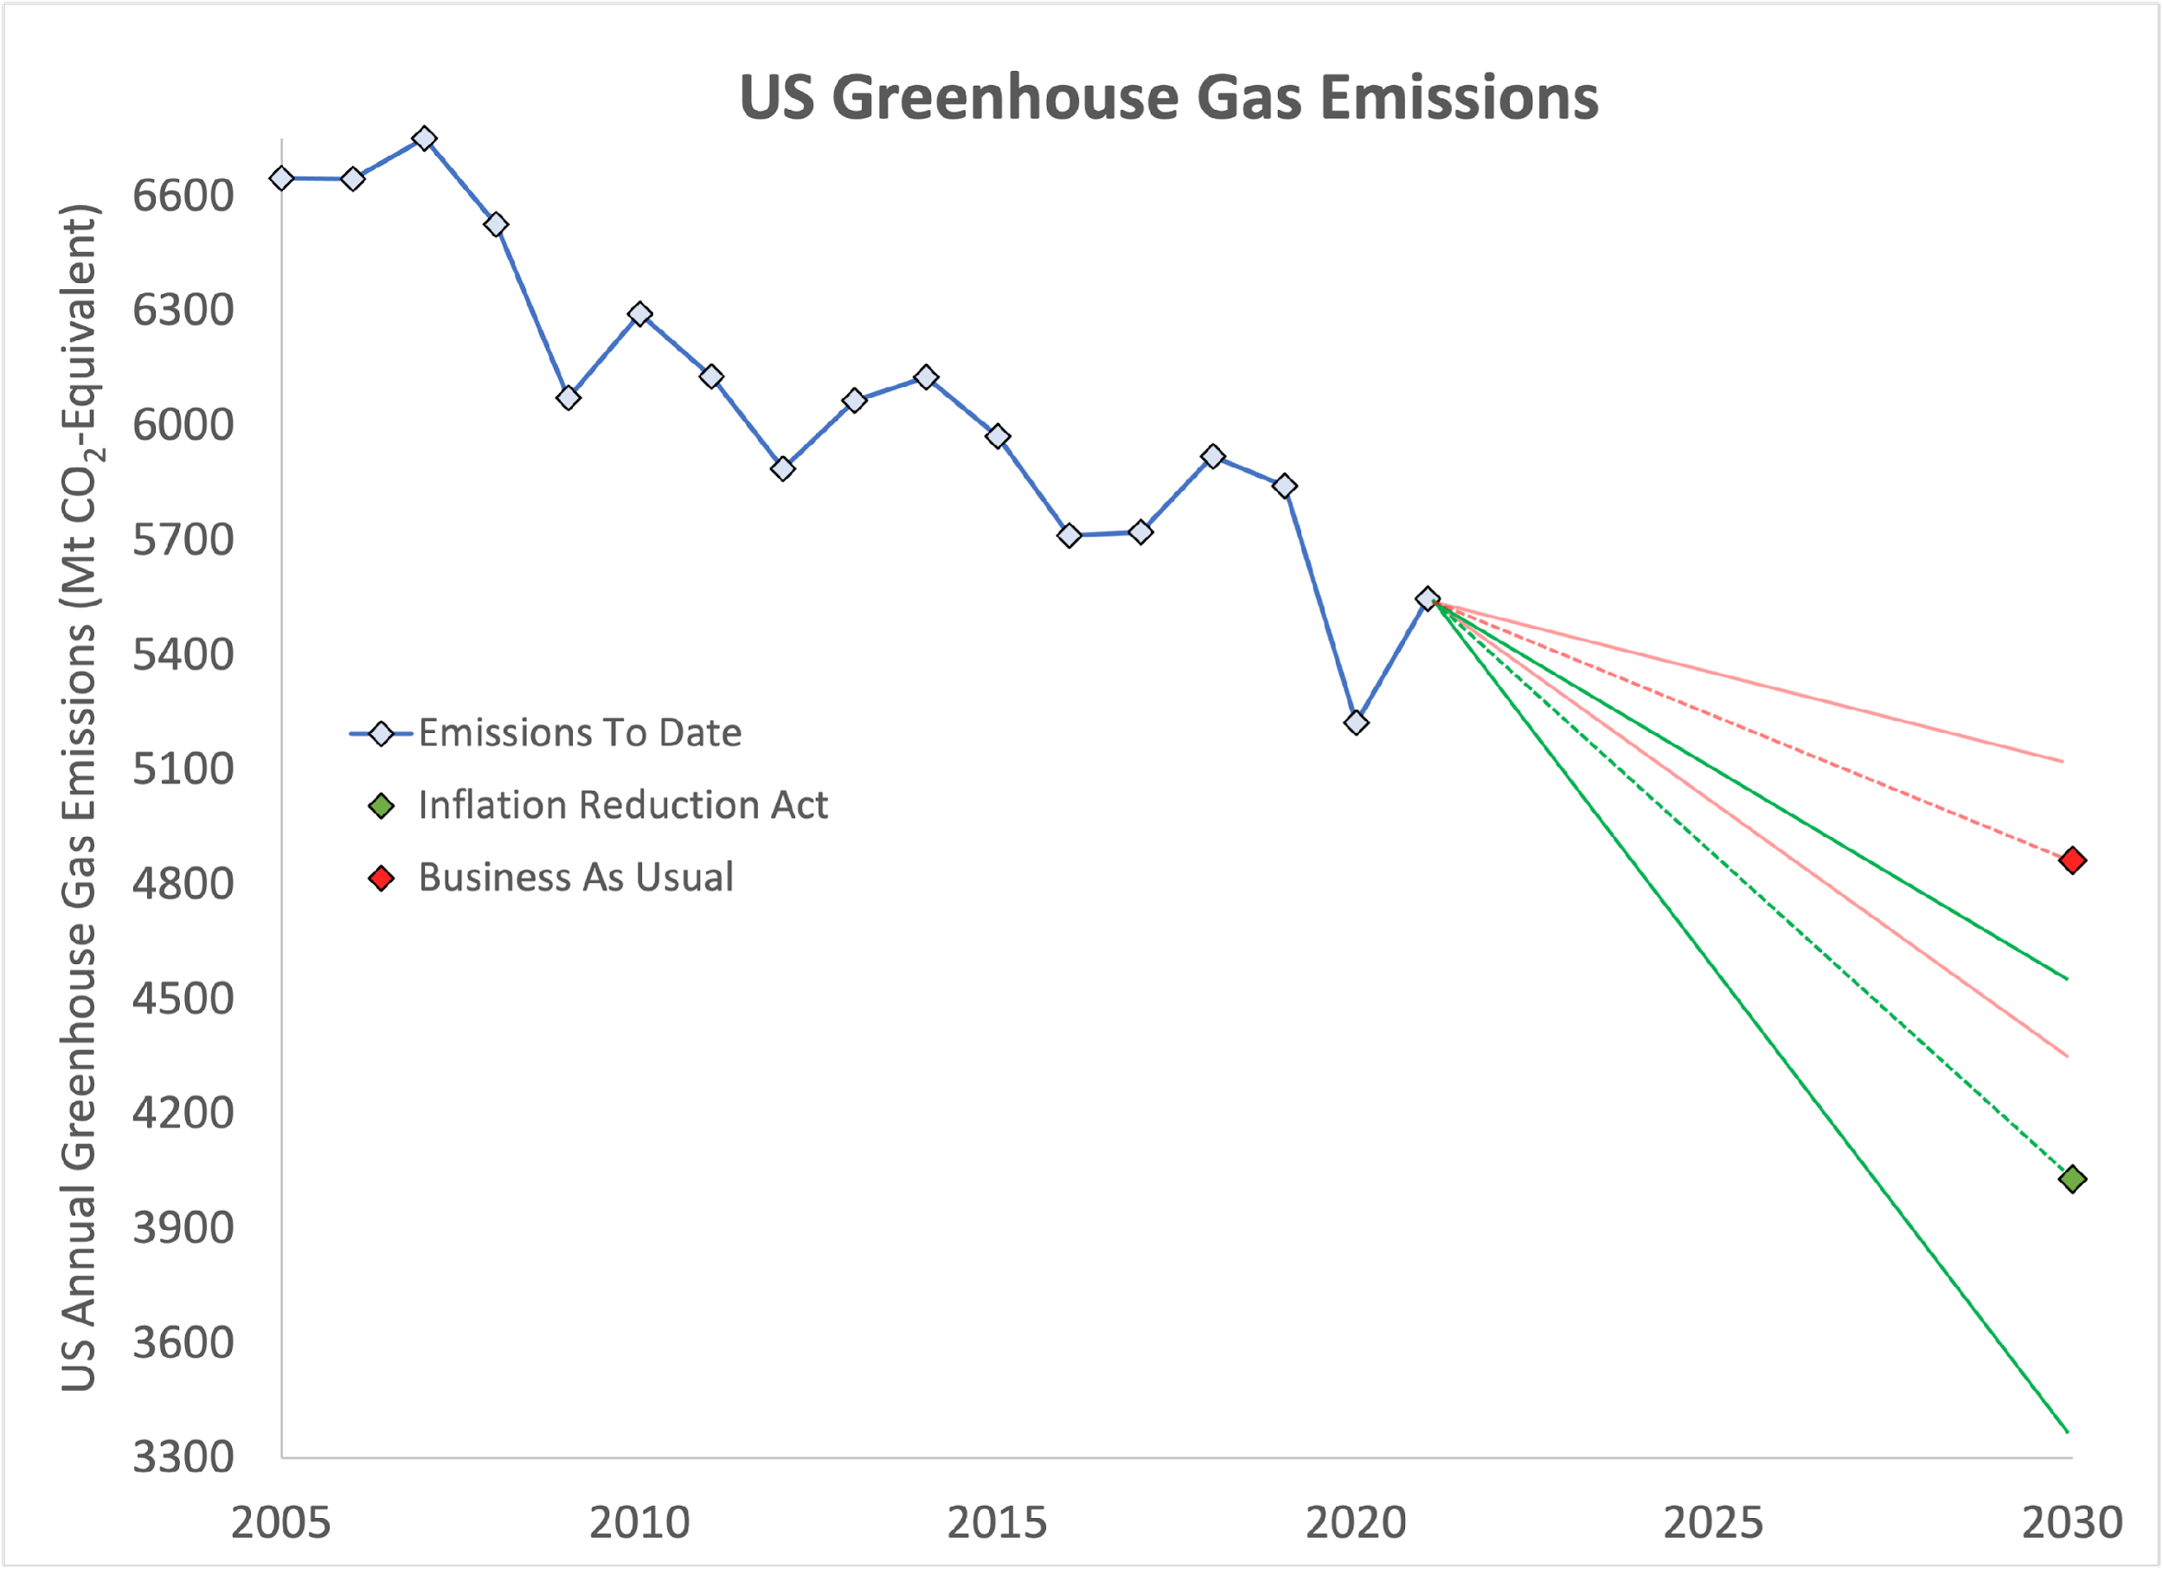
Business as Usual
27% cut
Inflation Reduction Act
40% cut
Paris
Target
Notes:
• The modelers predict that the Inflation Reduction Act will reduce emissions 40% below 2005 levels by 2030
- much closer to our 50% Paris commitment

Slide 8

How Does the Act Cut Emissions?
By giving money to people and institutions to make changes
  To state and local governments
  To businesses
  To homeowners, renters, and
  individuals
The act relies on people and
institutions to take up the
challenge
Notes:
• Simply put the Act empowers the government to give money
- in the form of grants, tax credits, and rebates
• To make changes that will reduce the U.S. emissions of greenhouse gases
• The Act requires federal agencies to set up a lot of programs to help lots of Americans and American institutions to invest in new technologies
- state and local governments
- businesses
- individuals, homeowners, renters, and car owners
• Most important point: the Act will only work if people voluntarily take up the challenge

Slide 9
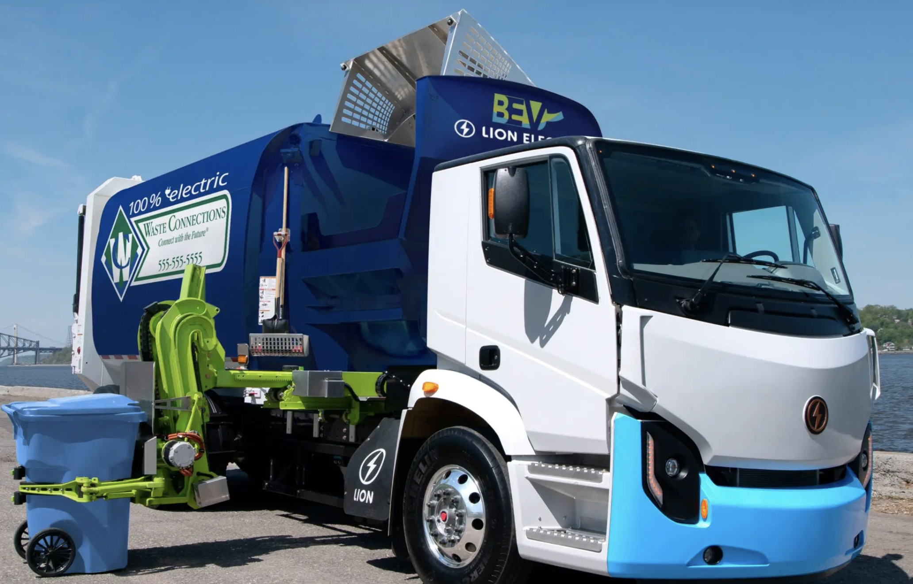
Aid to City Governments
Energy efficiency credits &
rebates for government
buildings
Rebates for zero emissions
garbage trucks and buses
Notes:
• Now, for just a small sampling of the kinds of programs that are included in the Inflation Reduction Act
• Cities would be able to get money for:
• Through tax credits to improve building energy efficiency for businesses:
• Grants to cities for electric buses and garbage trucks to reduce local air pollution
Sources: https://www.whitehouse.gov/briefing-room/statements-releases/2022/08/17/fact-sheet-inflation-reduction-act-advances-environmental-justice/
https://www.wipfli.com/insights/articles/cre-tax-how-you-can-claim-the-inflation-reduction-acts-green-building-tax-incentives

Slide 10

Aid to Farmers and Foresters
Money for conservation programs to store carbon in soil and trees
Climate-smart forest management and conservation
Notes:
• There’s an important role for farmers and foresters because they grow plants and trees that can absorb CO2 and trap it in the soil
- but they often can’t afford to pay for investments out of pocket
• Just to give you a feel for the many programs, let me just name a few in this sector
• Conservation programs like the Environmental Quality Incentives Program which gives:
- > $20 billion for climate-smart agriculture and forestry projects
- $2 billion from the Rural Energy for America Program for rural clean energy
- $450 million from the Landscape Scale Restoration Program to get private landowners to adopt climate-smart forestry practices
- $700 million from Forest Legacy Program for preserving forests on private lands
Source: https://yaleclimateconnections.org/2022/08/experts-senate-passed-bill-will-yield-myriad-climate-benefits/

Slide 11
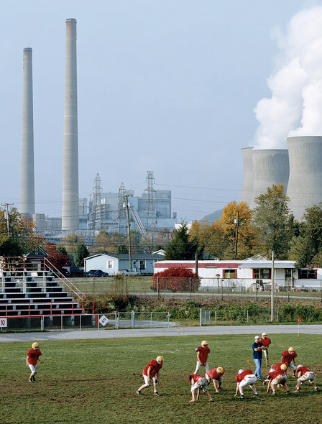
Aid to Disadvantaged Communities
Reduced pollution at key hubs:
  Ports
  Railways
  Airports
  Near schools
Grants for energy efficient affordable housing
Notes:
• Disadvantaged communities suffer from a disproportionate share of pollution and the effects of climate change
• Will get money for community-led projects to:
- Reduce pollution at transportation hubs including ports, railways, airports, & near schools
- Grants to improve the energy efficiency of affordable housing.
Source: https://www.whitehouse.gov/briefing-room/statements-releases/2022/08/17/fact-sheet-inflation-reduction-act-advances-environmental-justice/

Slide 12
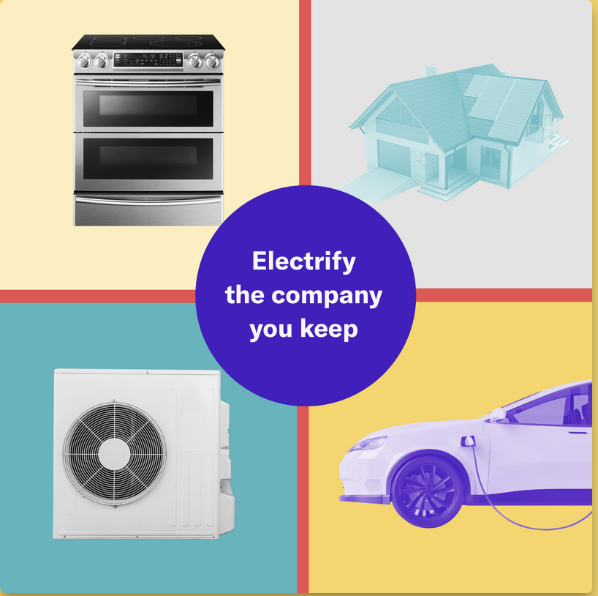

Rewiring America Savings Calculator
http://cclusa.org/ira-calc
Rebates available up to $14,000 per household, plus tax credits
100% cost coverage for low-income households
  Up to $83,000 per year
50% cost coverage for mid-income households
  $83,000 to $155,000
Rebates vs. tax credits
Notes:
• Now, let’s talk about how you can get a handle on the programs you could use to help reduce your own carbon footprint
• The home electrification and efficiency rebates in the bill include:
heat pumps for heating/air conditioning, water heaters, and clothes dryers
electric stoves;
electric cars;
home weatherization like improved insulation and windows;
rooftop solar and battery storage;
and wiring and breaker box upgrades.
• For low-income: will cover 100% of the costs of these upgrades up to $14,000
- low-income = 80% of median: Monmouth County: $83,000
• For middle-income: will cover 50% of the costs
- $83,000 — $155.000
• And higher income households can use tax cuts to help offset the costs

Slide 13
A Look at Rewiring America
https://www.rewiringamerica.org/
Notes:
Let’s take a look at Rewiring America
I’m going to take a hypothetical household’s situation

Slide 14
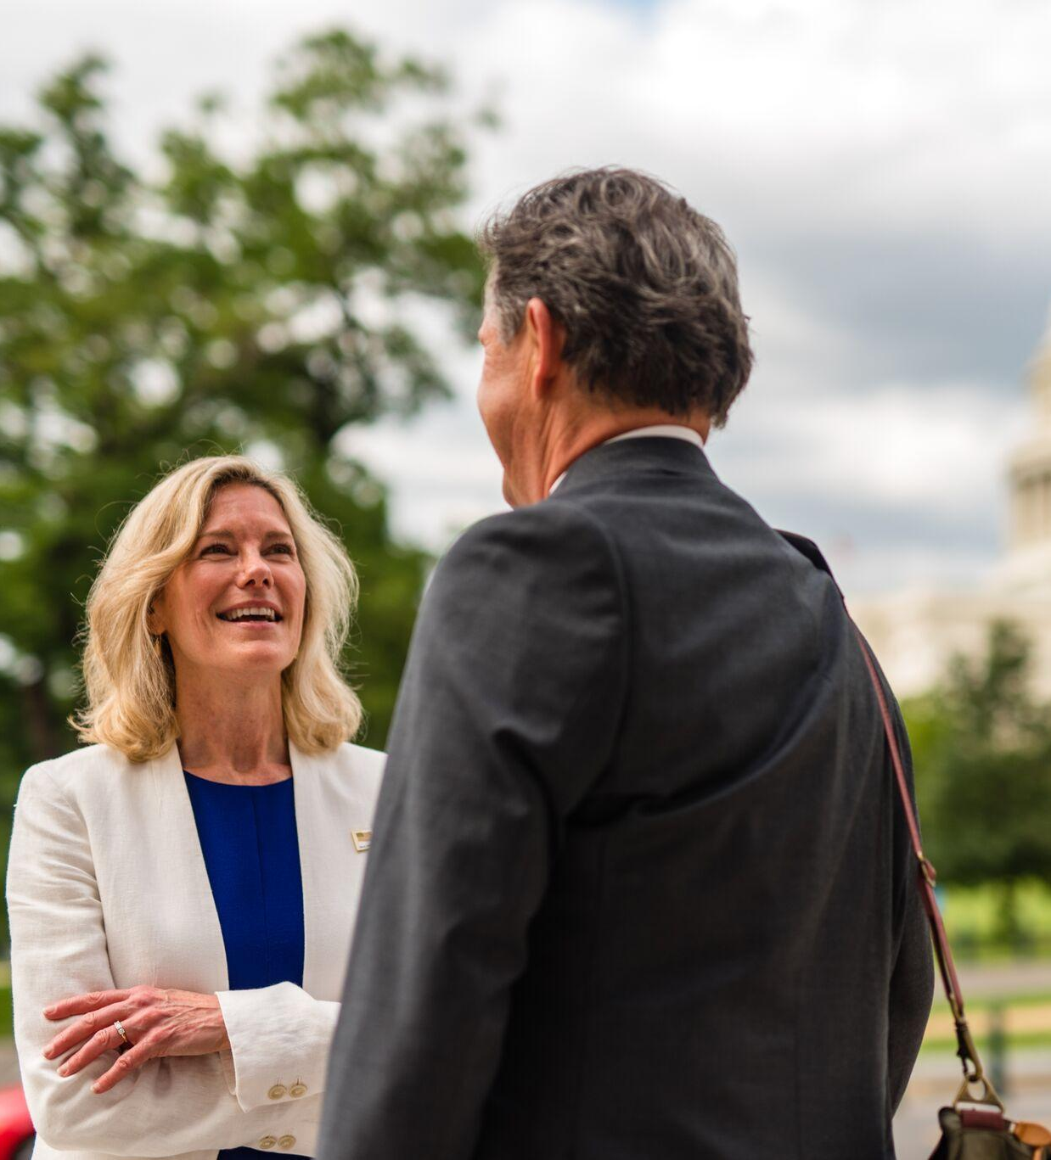
What’s Still Left to Do?
Local and state action to implement the funded programs
People and institutions must take the money and use it
Close the last 10% of our 2030 Paris commitment gap, then keep working to reach net zero by 2050
Notes:
• Many IRA programs require state & local governments to implement the funded programs
- Public pressure may be needed to take advantage of those programs
• IRA and other climate legislation in 2021 and 2022 make a lot of progress
- Still leave us short of our Paris commitment to cut emissions
- By 50% below 2005 levels by 2030
• To close the rest of that gap & move towards net zero emissions by 2050:
- Carbon fee and dividend or a carbon tax
- More electrification and efficiency policies
- Natural climate solutions like forests
• One great way: join Citizens’ Climate Lobby and help us achieve those goals.

Slide 15
Thank You!
Bob Morrow
E-mail: rmorrow602@gmail.com
Phone: 202-549-2771

